Slide 1
UNIT 2: Live Session!

Slide 3
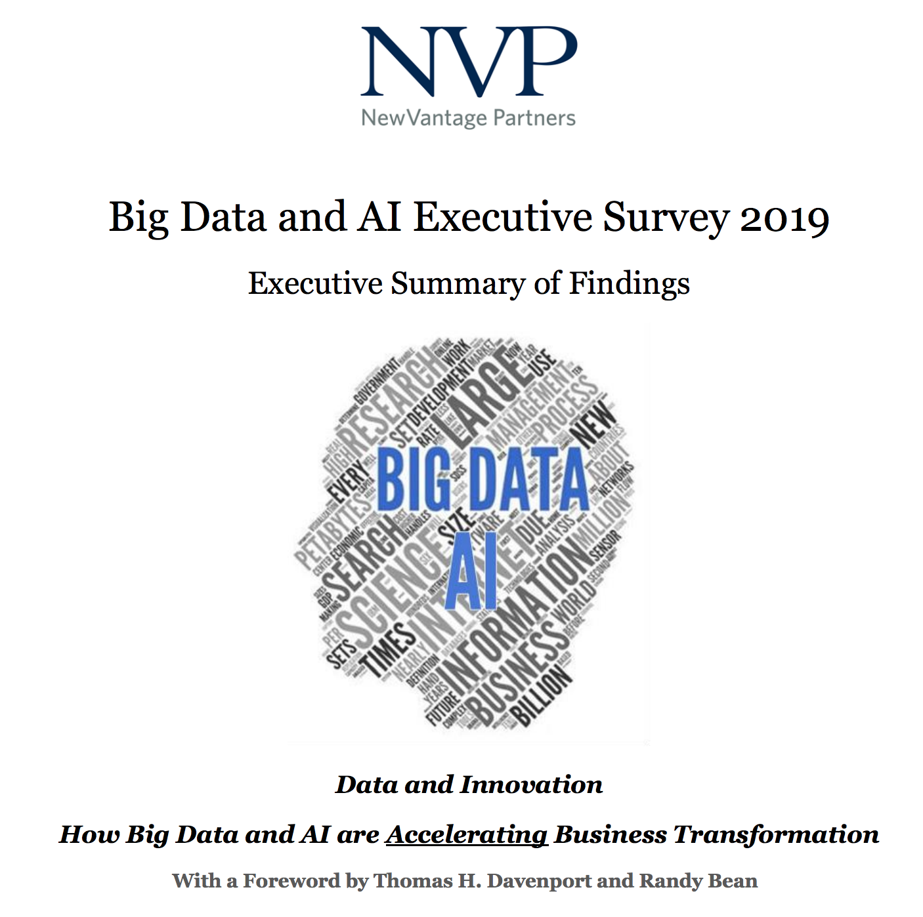
Data Science Trends!

Slide 4
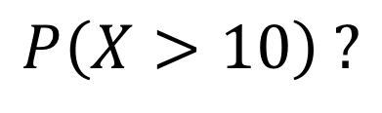
Question!
What is the probability that X is greater than 10?
$$P\left(X>10\right) ?$$

Slide 5
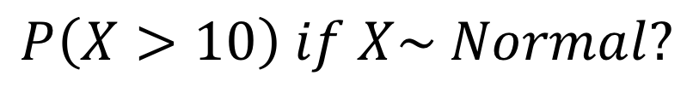
Question!
What is the probability that X is greater than 10 if X is normally distributed?
$$P\left(X>10\right) if X\sim Normal?$$

Slide 6
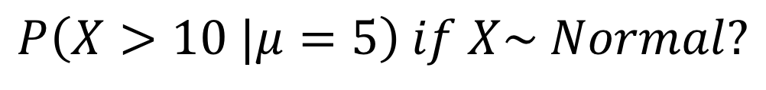
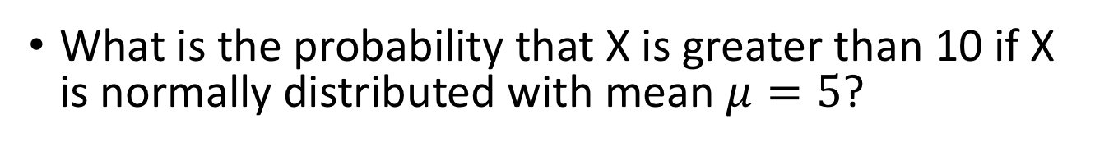
Question!
What is the probability that X is greater than 10 if X is normally distributed with mean $μ=5$?
$$P\left(X>10 |μ=5\right) if X\sim Normal?$$

Slide 7
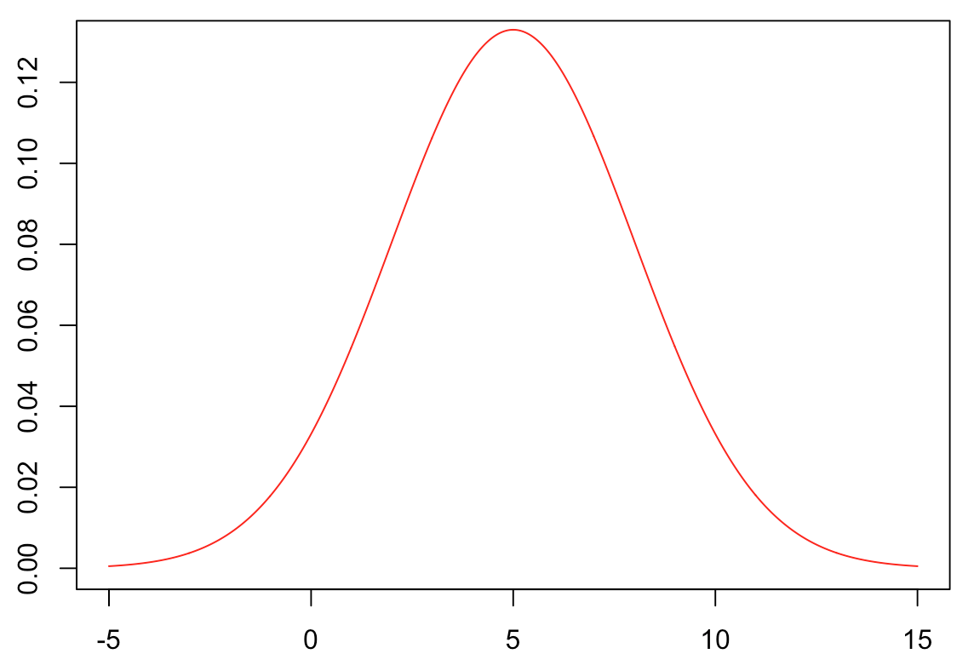
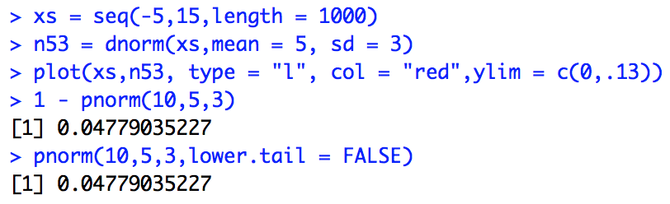
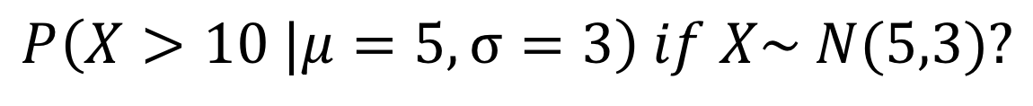
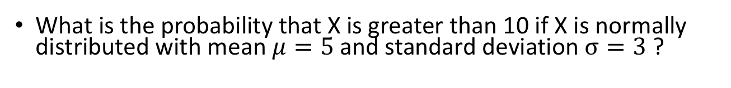
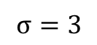
Question!
What is the probability that X is greater than 10 if X is normally distributed with mean $μ=5$and standard deviation $σ=3$ ?
$$P\left(X>10 |μ=5,σ=3\right) if X\sim N(5,3)?$$
$$σ=3$$

Slide 8
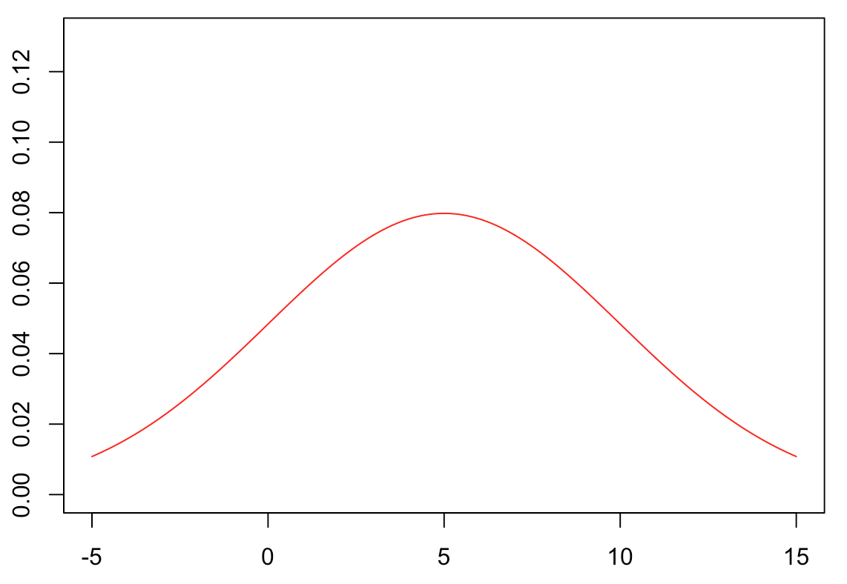
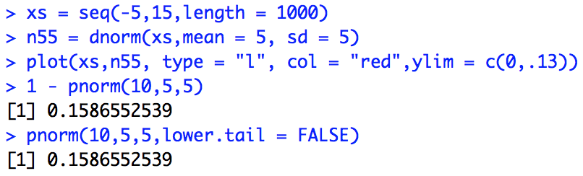
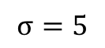
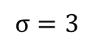
The Take Away….
In order to get accurate estimates of probabilities, we need to know how the probability is distributed.
$$σ=3$$
$$σ=5$$

Slide 9
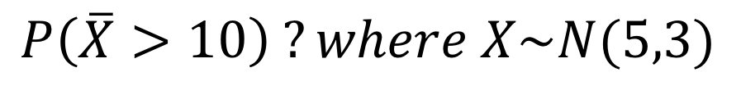
Question
What is the probability that the mean of 5 draws from a N(5,3) distribution is greater than 10?
$$P\left(\overline{X}>10\right) ?where X\sim N(5,3)$$
We want to know a probability!
We need to know how the probability is distributed!
Thus we need to know the
probability distribution of the sample mean!

Slide 10
Let’s Investigate Using Simulation in R!

Slide 11
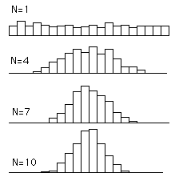
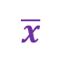
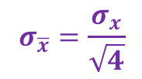
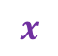
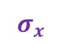
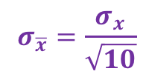
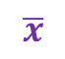
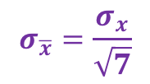
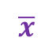
Central Limit Theorem (CLT)
$$x$$
$$σ_{x}$$
$$σ_{\overline{x}}=\frac{σ_{x}}{\sqrt{4}}$$
$$\overline{x}$$
$$σ_{\overline{x}}=\frac{σ_{x}}{\sqrt{7}}$$
$$\overline{x}$$
$$σ_{\overline{x}}=\frac{σ_{x}}{\sqrt{10}}$$
$$\overline{x}$$
µ

Slide 12
What Use Is This In the Real World?
How do we make better decisions using data?

Slide 13
Questions:
If I said I won the Texas Lottery, 10 times in a Row … do you think am playing fair?
Ho
Assumption: I am playing fair.
Evidence: Won the lottery 10 times in a row.
Pvalue
Probability : The probability of winning the lotter 10 times in a row, if I am playing fair, is very very small.
Reject Ho
Conclusion: Since the the probability of what I observed is very small if the assumption is true, I will conclude that the evidence suggests that the assumption (that I am playing fair) is false … and conclude that I am cheating.
If I said I have a 95% free throw percentage in basketball, and I go to the gym and I make 52 out of 100 free throws, do you think I am lying?
Ho
Assumption:
Evidence:.
Pvalue
Probability :
Reject Ho
Conclusion:
If what you observe happens very rarely under some assumption then you may choose to conclude that the assumption in false.
Examples: Lottery / Basketball / Shoe Sizes
“If the probability that ______________________ under the assumption that _________________ is very small … then I will conclude that the assumption is false. “
Yes… we could be making an error!
But in order to do this, we of course need to be able to accurately obtain probabilities.
To accurately obtain probabilities, we have to know how the probability is distributed across the possible values of what we are interested in.
Example I think the average shoe size is 7 and I would like to test this hypothesis.
Generate what the world would look like if this were true.
Find the probability of what you observed using this generation.
Compare with the result of the t test and z test.

Slide 14
Questions:
If I said I won the Texas Lottery, 10 times in a Row … do you think am playing fair?
Ho
Assumption: I am playing fair.
Evidence: Won the lottery 10 times in a row.
Pvalue
Probability : The probability of winning the lotter 10 times in a row, if I am playing fair, is very very small.
Reject Ho
Conclusion: Since the the probability of what I observed is very small if the assumption is true, I will conclude that the evidence suggests that the assumption (that I am playing fair) is false … and conclude that I am cheating.
If I said I have a 95% free throw percentage in basketball, and I go to the gym and I make 52 out of 100 free throws, do you think I am lying?
I make 95% of my free throws.
Ho
Assumption:
Evidence:.
I only made 52% of my free throws in my 100 shots.
The probability that I would make only 52% of free throws if I had a
95% free throw percentage is very small.
Pvalue
Probability :
Reject Ho
Since the probability that I would only hit 52% if my real percentage
was 95% is very small, I will reject the assumption as conclude that
my real percentage is less than 95%.
Conclusion:
If what you observe happens very rarely under some assumption then you may choose to conclude that the assumption in false.
Examples: Lottery / Basketball / Shoe Sizes
“If the probability that ______________________ under the assumption that _________________ is very small … then I will conclude that the assumption is false. “
Yes… we could be making an error!
But in order to do this, we of course need to be able to accurately obtain probabilities.
To accurately obtain probabilities, we have to know how the probability is distributed across the possible values of what we are interested in.
Example I think the average shoe size is 7 and I would like to test this hypothesis.
Generate what the world would look like if this were true.
Find the probability of what you observed using this generation.
Compare with the result of the t test and z test.

Slide 15
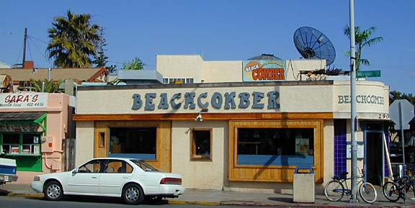
Example: 1 Sample Confidence Interval
The following are ages of 7 randomly chosen patrons seen leaving the Beach Comber in South Mission Beach at 7pm! We assume that the data come from a normal distribution and would like to test the claim that the mean age of the distribution of Comber patrons is different than 21.
25, 19, 37, 29, 40, 28, 31

Slide 16
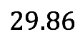
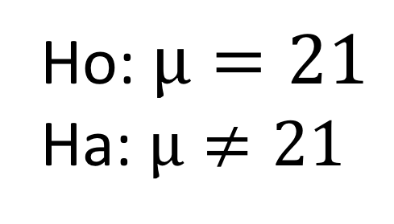

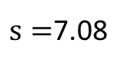
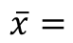
Let’s Formalize This Test Into 6 Steps!
We would like to test the claim that the population mean is d$ifferent than 21.$
Ho: $µ=21$
Ha: $µ≠21$
Assumption:
Evidence:
25, 19, 37, 29, 40, 28, 31
$$\overline{x}=$$
$s=$7.08
Probability
?

Slide 17
Since we are trying to make a decision about the mean, and we need a probability to make that decision … it would be helpful to know the probability distribution of the sample mean!
AND WE DO!
THE CLT!

Slide 18
Let’s Get Back to Simulation!

Slide 19
Let’s Formalize This Test Into 6 Steps!
We would like to test the claim that the population mean is d$ifferent than 21.$
Ho: $µ=21$
Ha: $µ≠21$
Assumption:
Evidence:
25, 19, 37, 29, 40, 28, 31
$$\overline{x}=$$
$s=$7.08
Probability
?

Slide 20
So what is a t-test then?

Slide 21
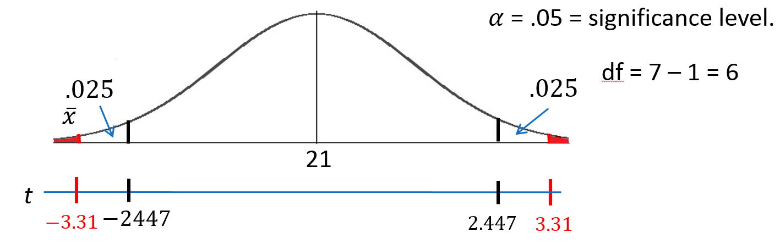
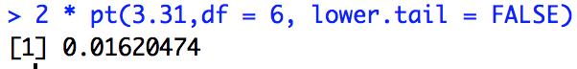
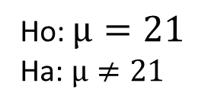
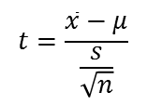
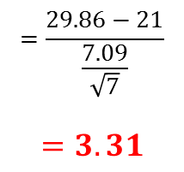
Revised Write Up!
We would like to test the claim that the population mean is greater than $4.$ To do this we take a sample of size n = 8 and find that $\overline{x}$ = 29.86 years and s = 7.09 years.
Ho: $µ=21$
Ha: $µ≠21$
Step 1: Identify the null (Ho) and alternative (Ha) hypothesis.
Step 2: Draw and Shade and Find the Critical Value.
$$t=\frac{\overline{x}−μ}{\frac{s}{\sqrt{n}}}$$
$$=\frac{29.86−21}{\frac{7.09}{\sqrt{7}}}$$
$$=3.31$$
Step 3: Find the test statistic. (The t value for the data.)
Step 4: Find the pvalue: Pvalue = .0162 < .05
Step 5: REJECT HO
Step 6: There is sufficient evidence to conclude that the true mean age of patrons at the Comber at 7pm is greater than 21 (pvalue =.0162 from a t-test).

